Slide 1


Postgraduate major project An LSTM based approach to classification of mental health issues using Natural Language Processing
SID: 0925739

Slide 2
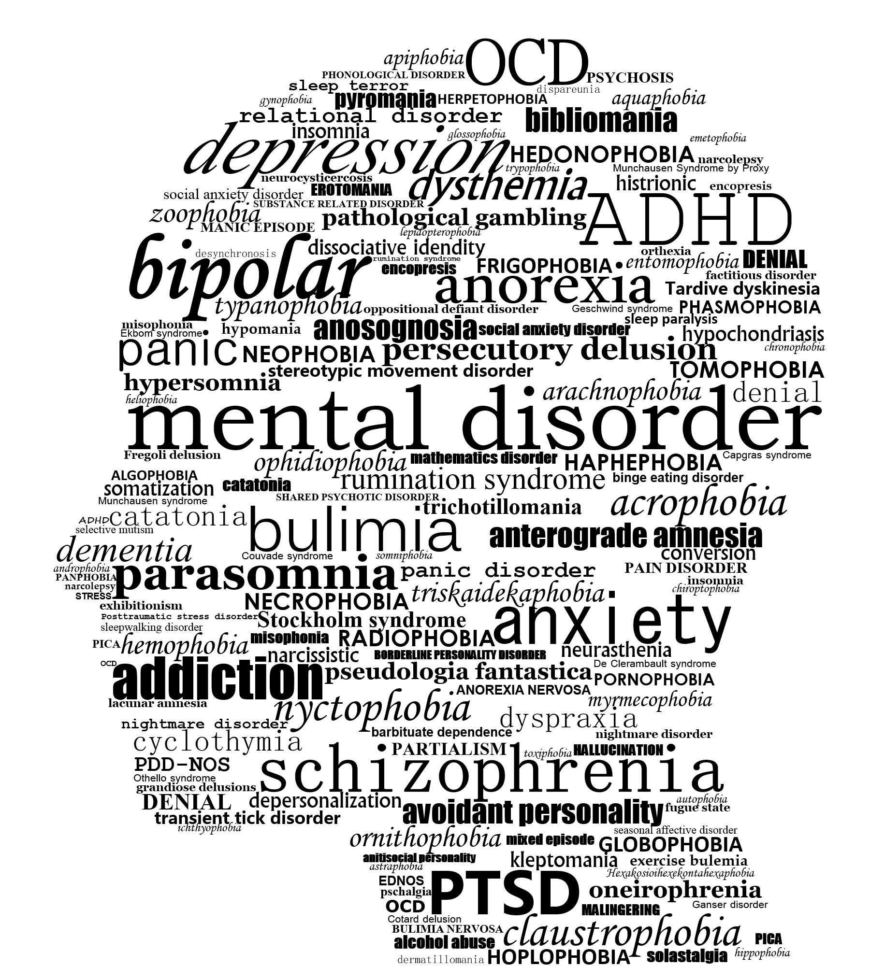
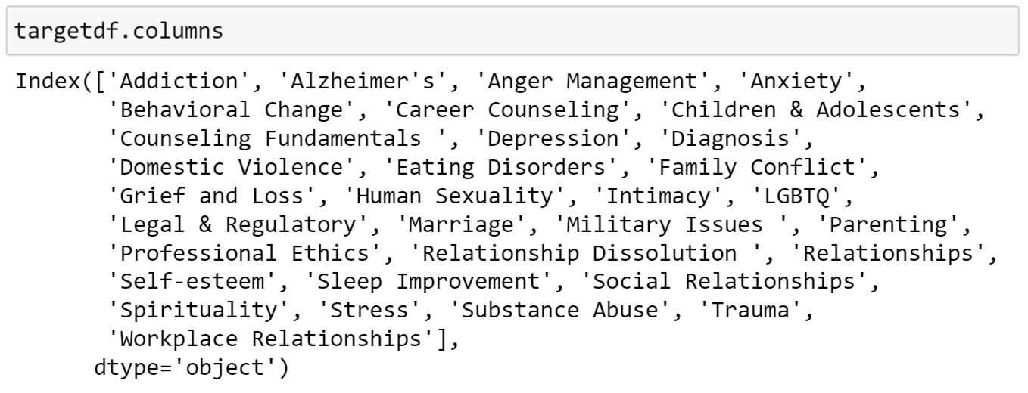
Aims and objectives
To process the natural language description of the end-user’s mental health issue using NLP techniques.
To classify the processed data into different categories of mental health issues using sequence modelling techniques.

Slide 3
Motivation
According to the World Health Organisation (WHO), more than 264 million people of all ages suffer from depression resulting from various mental health issues.
It is useful to create a system which can automatically classify the mental health issue into its category so that the patient can be directed towards relevant therapy without having to go through initial assessment.

Slide 4
Key Theoretical Aspects
NLP’s primary goal is to create a machine that can pass Turing test.
NLP can be broken down into many sub-tasks:
Noise Removal
Tokenisation
Normalisation
Stemming
Lemmatisation
POS Tagging
Stop words removal
Word indexing and padding
Word Embeddings
Sequence Modelling
Recurrent Neural Networks (RNN)
Long Short Term Memory (LSTM) cells

Slide 5
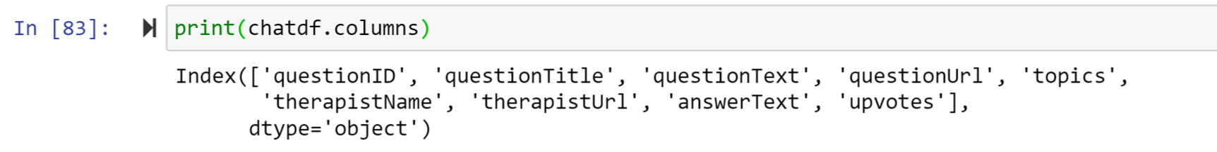
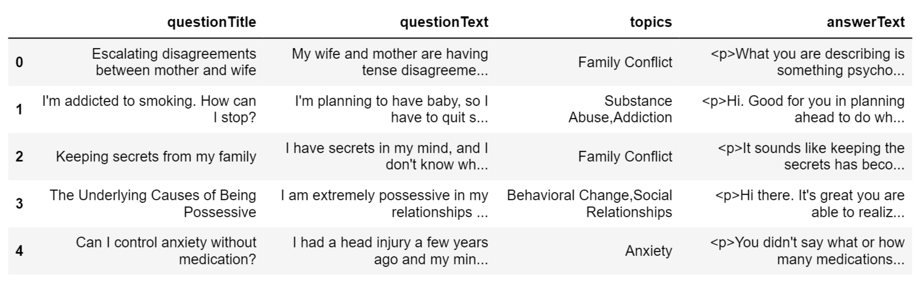
Methodology
Secondary Research
Counselchat Dataset
Counselchat.com counselling data provided by the founders to Nicolas Bertagnoli. Data available to use from his public github repository
Quantitative Analysis
Ethical Considerations
Columns with therapist’s name and therapist’s URL removed before processing

Slide 6
Noise Removal
Regex expressions to remove HTML tags, capitalisations and punctuations
'My wife and mother are having tense disagreements. In the past, they’ve had minor differences. For example, my wife would complain to me my mother is too overbearing; my mother would complain my wife is lazy.\r\nHowever, it’s intensified lately. I think the cause is my wife talked back to her once. Now, any little disagreement is magnified, leading to major disagreements. What can I do?'
my wife and mother are having tense disagreements in the past they ve had minor differences for example my wife would complain to me my mother is too overbearing my mother would complain my wife is lazy however it s intensified lately i think the cause is my wife talked back to her once now any little disagreement is magnified leading to major disagreements what can i do

Slide 7
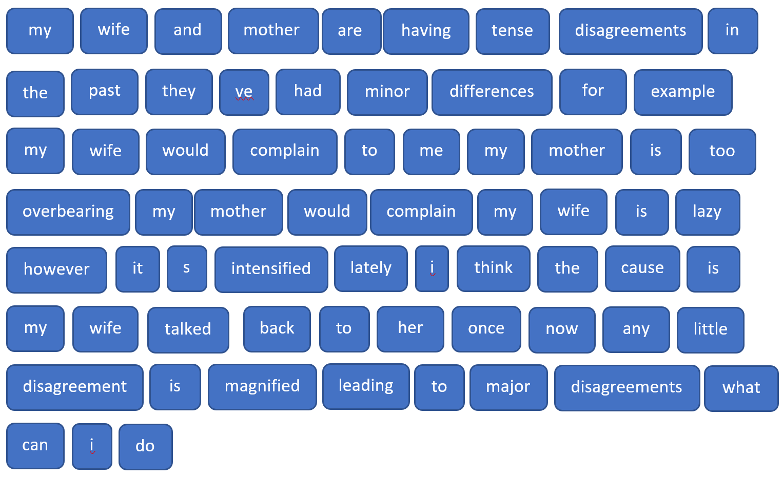
Tokenization
Sentences broken down into individual words
my wife and mother are having tense disagreements in the past they ve had minor differences for example my wife would complain to me my mother is too overbearing my mother would complain my wife is lazy however it s intensified lately i think the cause is my wife talked back to her once now any little disagreement is magnified leading to major disagreements what can i do

Slide 8
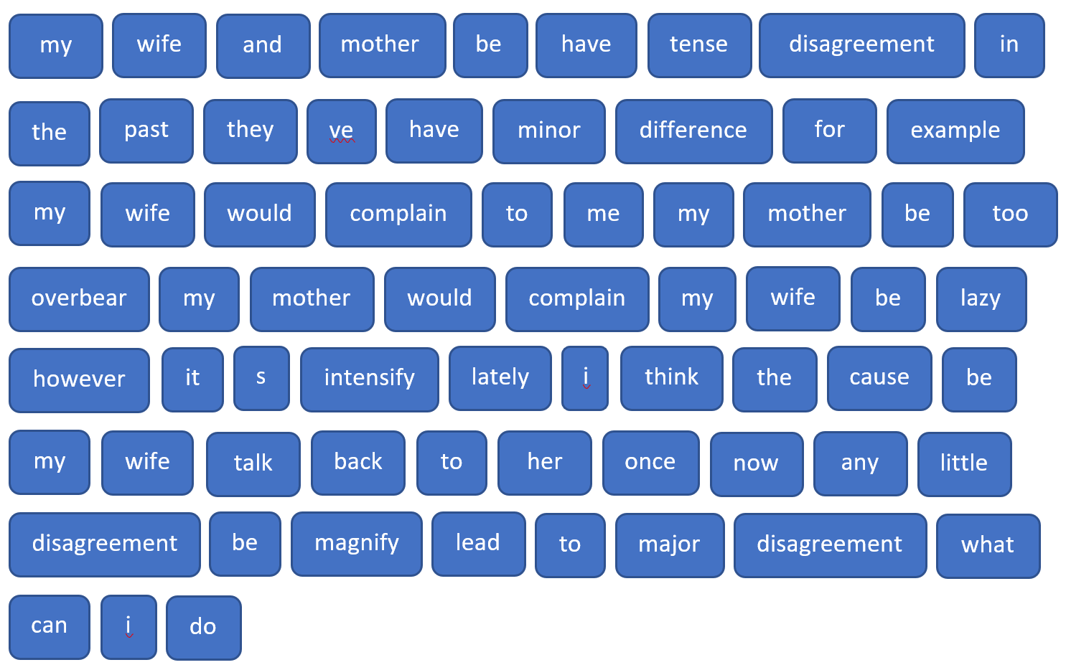
Lemmatization with POS - TAgging
Every word token is checked for its part of speech and converted to its root form
WordNet Synsets used to identify the part of speech

Slide 9
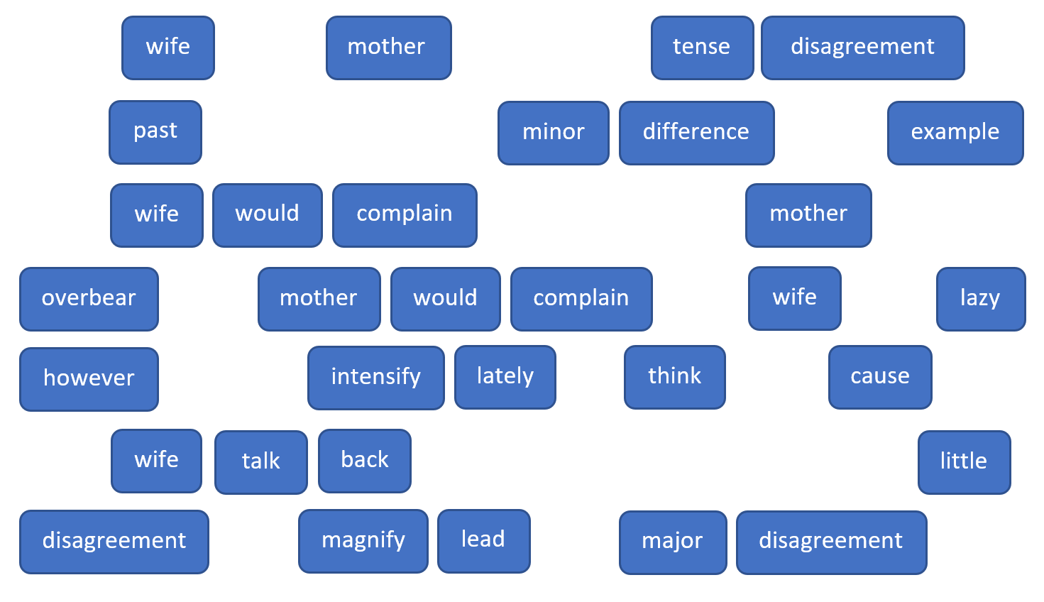
Stop words removal
All English sentences have commonly occurring words like is, am, are, my, has, have etc
These can occur is almost all data samples and due to this the classification model could get confused
These words must be removed to add to the distinctness of each individual data samples

Slide 10
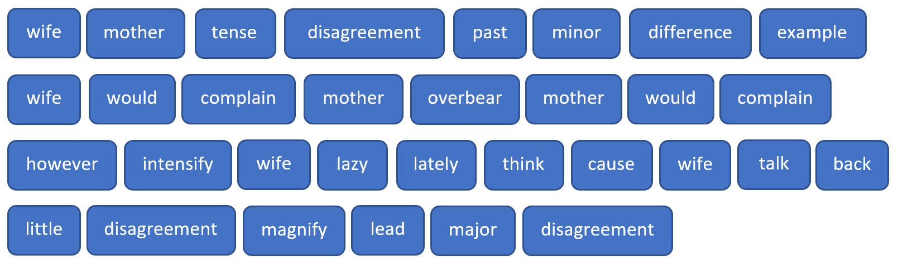
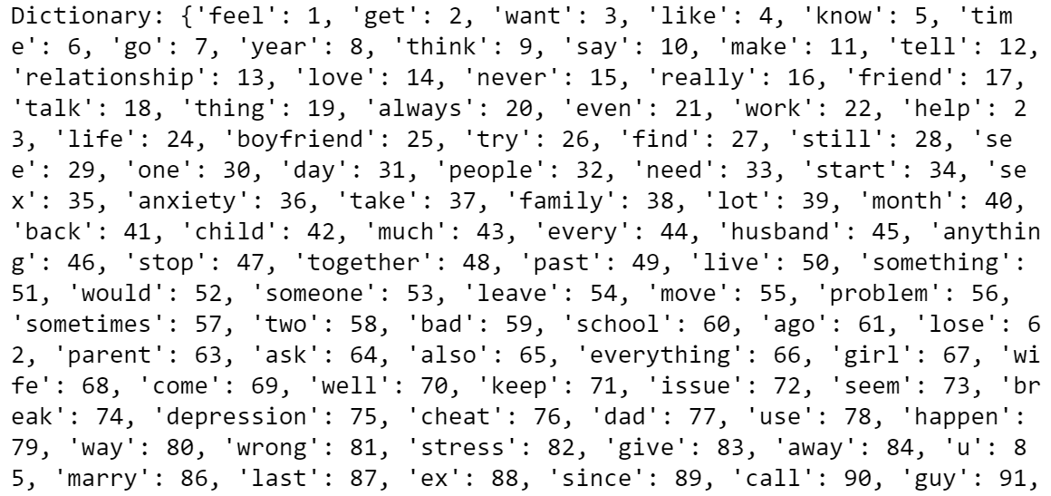
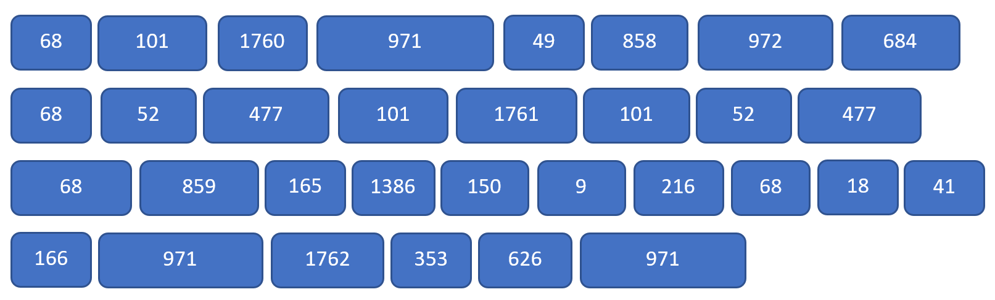
Conversion to numerical data
Keras pre-processing tokenizer to assign indices to all words within the entire dataset that creates a word-index dictionary
Conversion of each individual sample to their token to index map

Slide 11
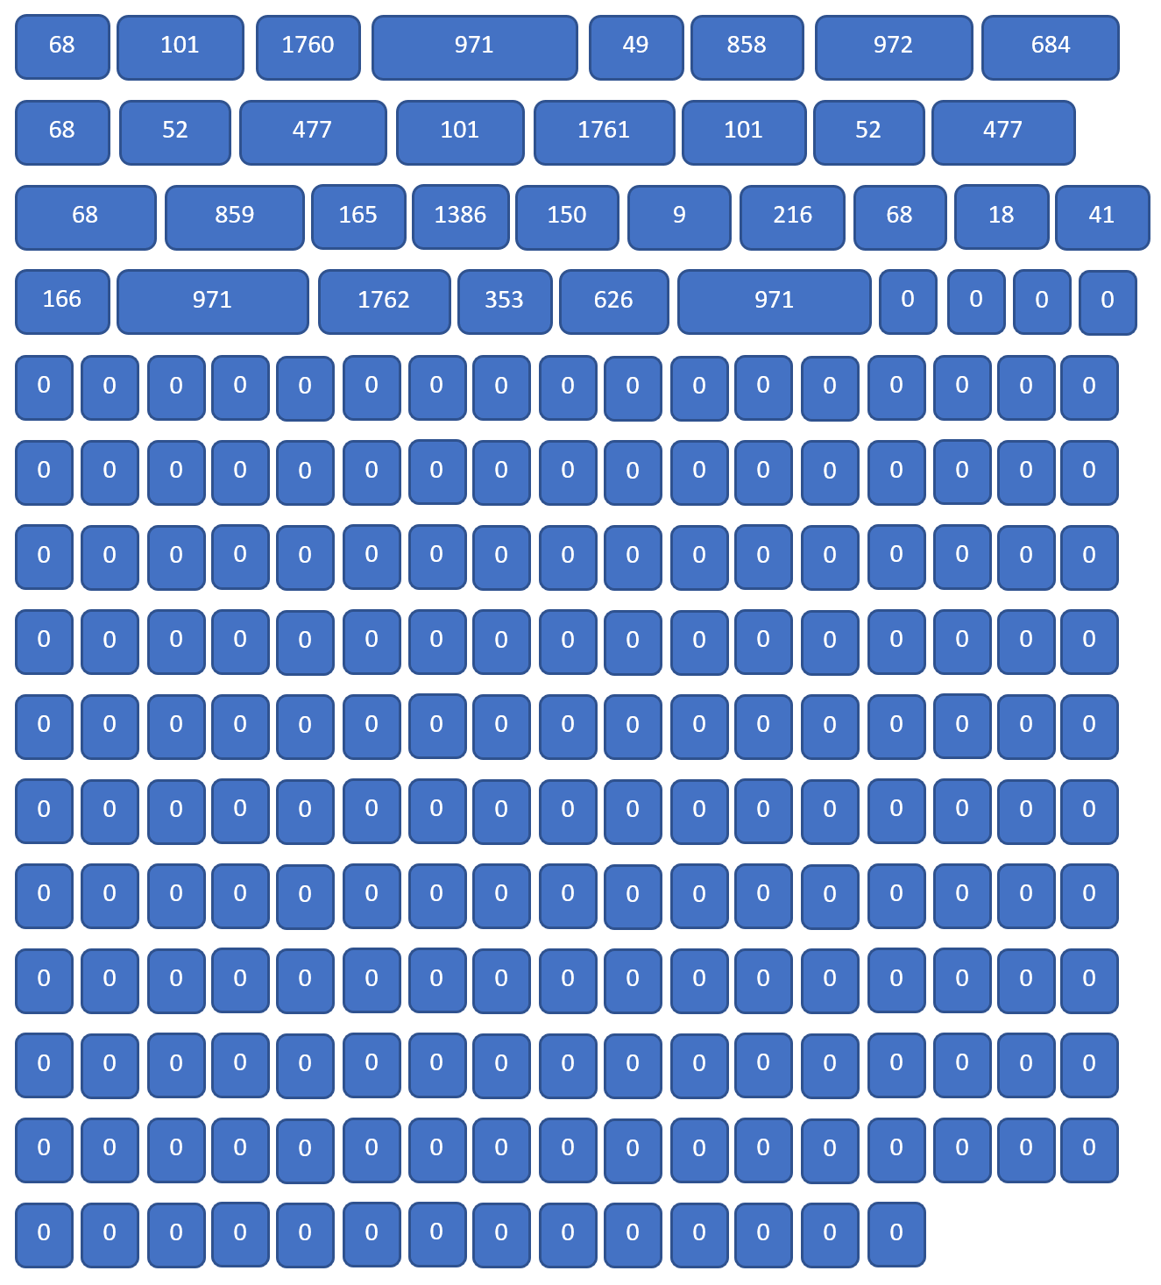
Padding
ML and DL models accept data samples with same dimensions.
Token lengths for all samples must be the same.
Max length is figured out by checking the longest sentence within the dataset. In this case 220 tokens.
All sentences shorter than max length will be post-padded with zeros.

Slide 12
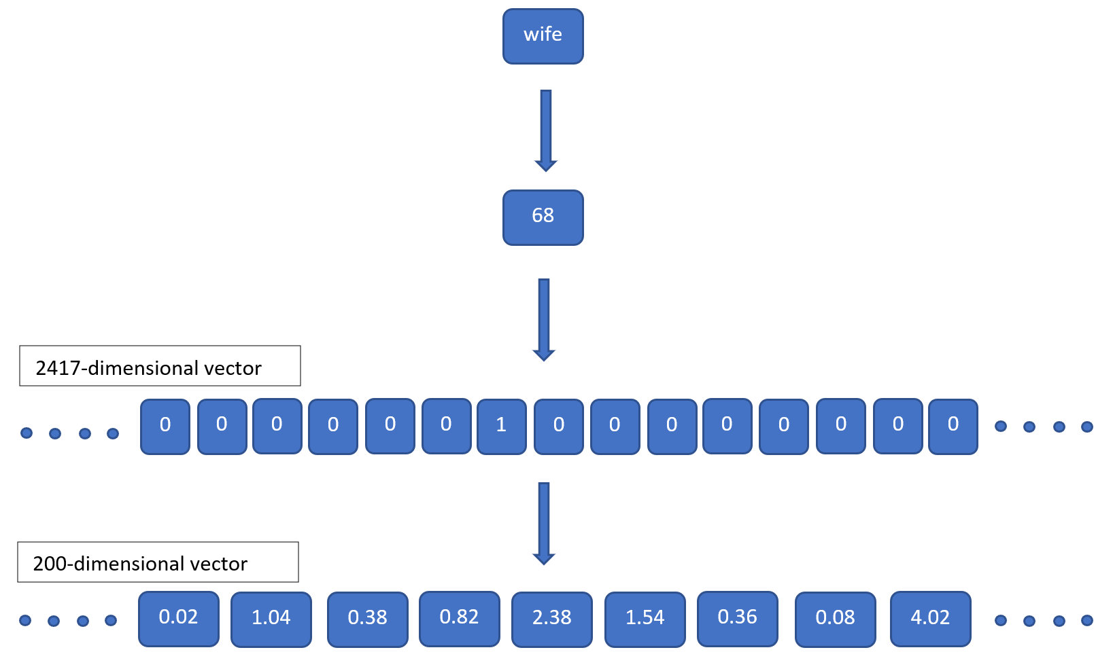
Word Embeddings
Vector Representations for each token
This is done in NLP because converting each token as a one-hot vector results in a high number of dimensions. In this case, 2417 dimensions which is the total length of the word index dictionary
Language models like Bag-of-words and tf-idf (term frequency – inverse document frequency) are used to convert one-hot tokens into vectors of lesser dimensions.
In this case 200 dimensional vector was assigned which is a hyperparameter of the embedding layer

Slide 13
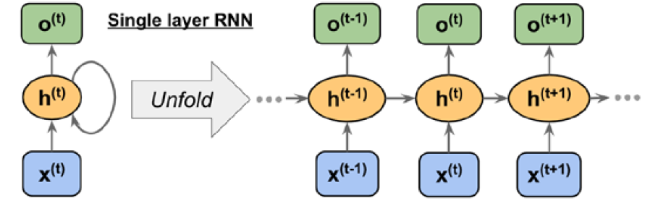
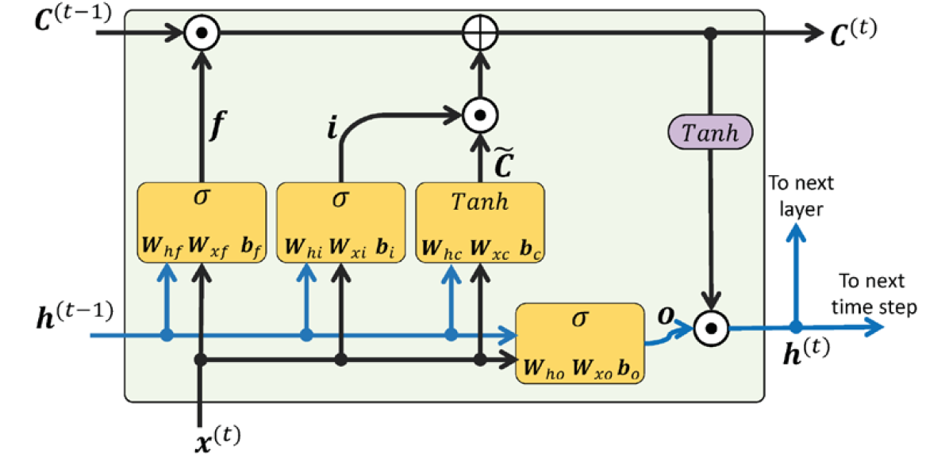
Neural Network Design
RNNs are great for sequence modelling
However, they suffer from exploding and vanishing gradients as sequences become longer which is a common case in NLP.
LSTM cells as proposed by Hochreiter and Schmidhuber (1997) is the state-of-the-art solution.
The main working principle of LSTM is that the cell state from previous timestep is modified to get the cell state at current timestep. And the flow of data is not controlled by weight but by computational units called gates.

Slide 14
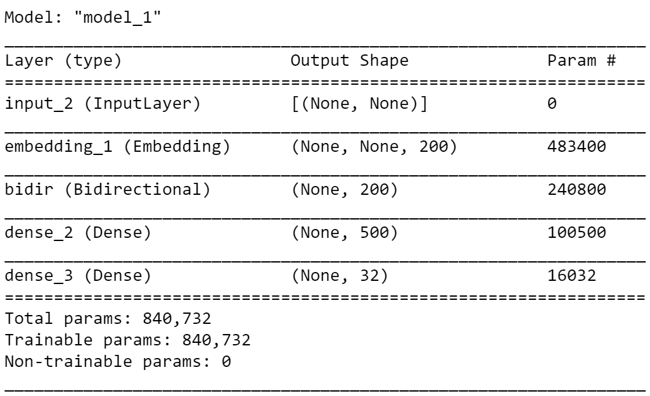
Neural Network Design
inputs = tf.keras.layers.Input(shape=(None,))
embedding = tf.keras.layers.Embedding(num_question_tokens, 200, mask_zero=True)(inputs)
lstm_outputs = tf.keras.layers.Bidirectional(tf.keras.layers.LSTM(100, return_state=False), name='bidir') (embedding)
dense_outputs = tf.keras.layers.Dense(500, activation=tf.keras.activations.relu) (lstm_outputs)
outputs = tf.keras.layers.Dense(32, activation=tf.keras.activations.softmax) (dense_outputs)
model = tf.keras.models.Model(inputs, outputs)
model.compile(optimizer='adam', loss='categorical_crossentropy', metrics=['accuracy'])
Bi-directional LSTM chosen so that the model goes through the sequence from both start to end and vice versa.
32-neuron output chosen for softmax classification to 32 categories
Adam optimizer
Categorical cross entropy as the loss function
840,732 total parameters

Slide 15
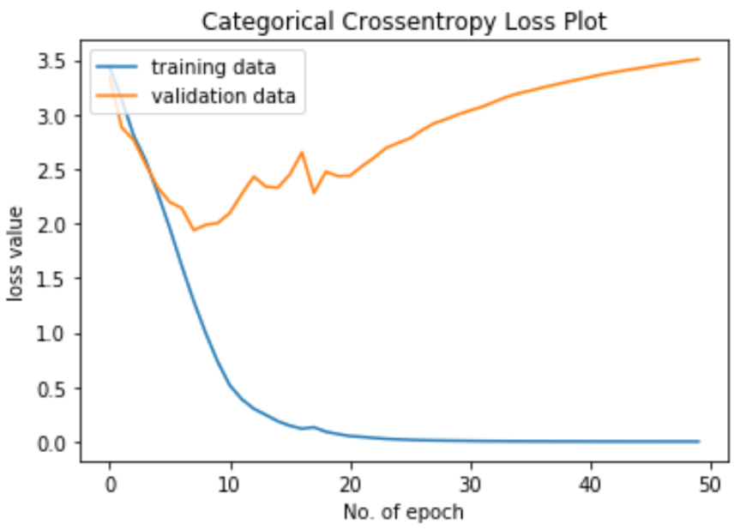
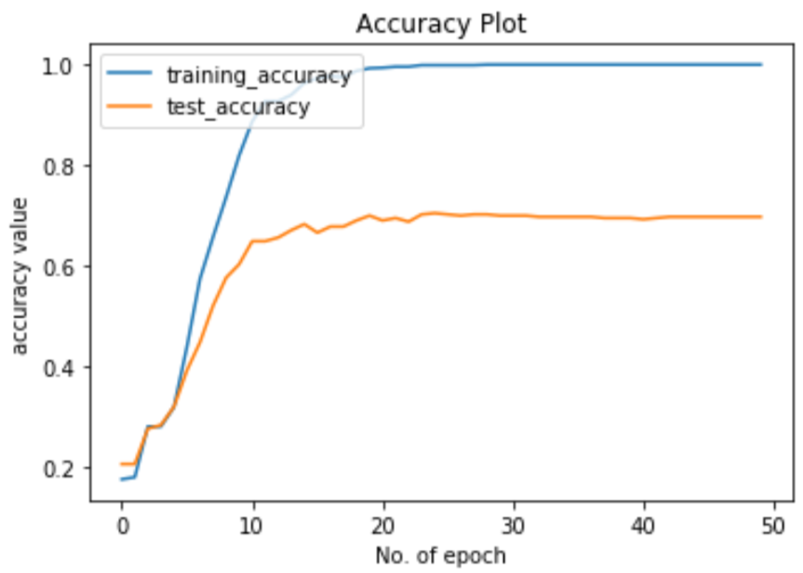
Results
Network converges around 20 epochs
Training accuracy converges to even 100% however we stop the training early to avoid overfitting.
Best validation accuracy of 70% observed.
Further improvements in overfitting can be made by using dropout layers.
It is possible that more data can result into better convergence in validation set.

Slide 16
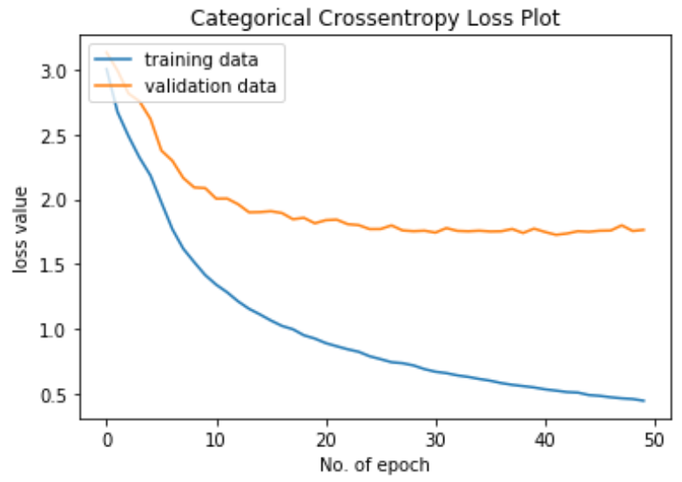
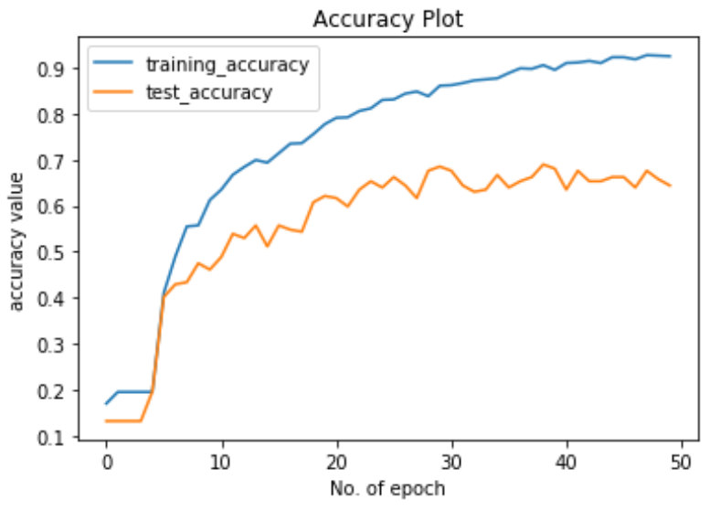
Further Experiment - BERT
Bidirectional Encoder Representations from Transformers (BERT)
Provides dense vector representations for natural language by using a deep, pre-trained neural network with the Transformer architecture
Jacob Devlin and colleagues created and published in 2018
Trained on the BooksCorpus with 800M words and a version of the English Wikipedia with 2,500M words
Better convergence graph compared to LSTM with best validation accuracy of 68.95% observed.

Slide 17
Discussion & Conclusion
Such a system where user provides description of mental health issue in natural language and it is then classified into categories of mental health issues is possible.
Datasets with around 1500 samples can result in a model that is about 70% accurate.
The baseline for this project is the topic prediction as reported by Nicolas Bertagnoli in his Medium article which shows accuracy at about 67%. The LSTM model performs better than that.
Larger datasets can provide for more accuracy as there will be more word tokens which will provide further dimensions to the features available for the LSTM network to train on.

Slide 18
TEST with Unseen text
‘I have arguments with my husband everyday. Our marriage is failing and I cannot seem to resolve it. We have recently considered divorce and it has affected me mentally.’
Predicted correctly as ‘Relationships’

Slide 19
references
Hochreiter, S. and Schmidhuber, J., 1997. Long Short-Term Memory. Neural Computation, 9(8), pp. 1735-1780.
Bertagnolli, N., 2020. Counsel Chat: Bootstrapping High-Quality Therapy Data, Medium. [online] Available at: <https://towardsdatascience.com/counsel-chat-bootstrapping-high-quality-therapy-data-971b419f33da> [Accessed 29/09/2020]
WHO, 2020. Depression: Key Facts. [online] Available at: <https://www.who.int/news-room/fact-sheets/detail/depression> [Accessed: 29/09/2020]

Slide 20
Questions ?

